Slide 1
Fire of Eidolon
Team Meatball:
Mark Sneddon, Travis Carlisle, Josh Mecham, Tye Foster
Notes:
Tye

Slide 2
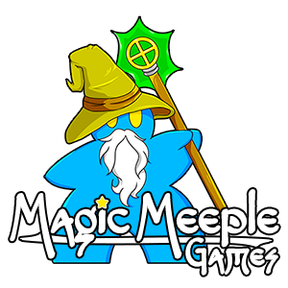
Special Thanks to
Ian Stedmen
and
Magic Meeple Games
for their support
Notes:
Tye

Slide 3
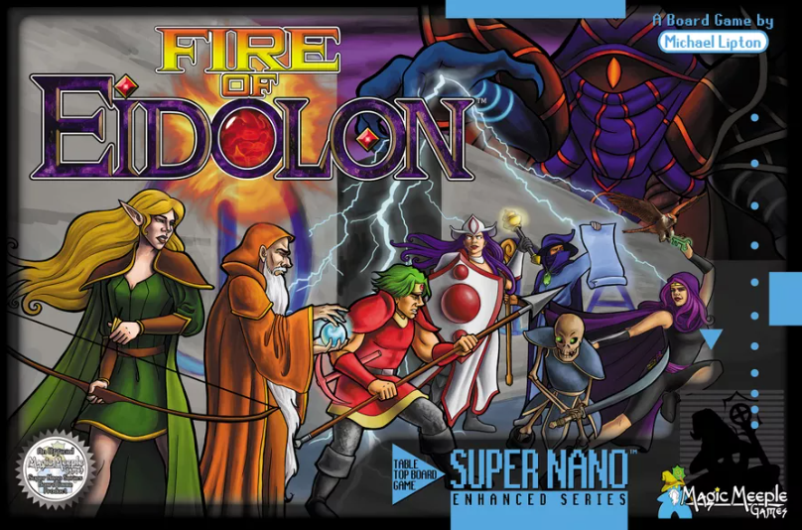
Problem Description
Fire of Eidolon is a board game created by Magic Meeple Games where players work cooperatively to find their way through a maze-like dungeon to unlock and escape with the titular Fire of Eidolon
Our goal was to emulate this board game and using path planning methodology, complete the game autonomously.
Notes:
Josh

Slide 4

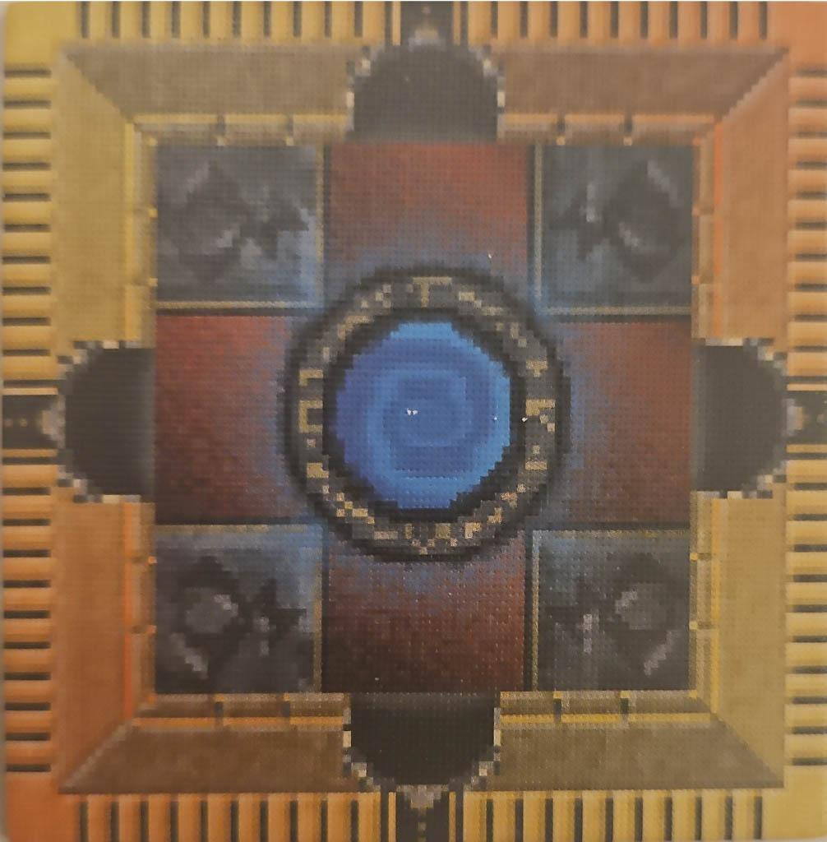
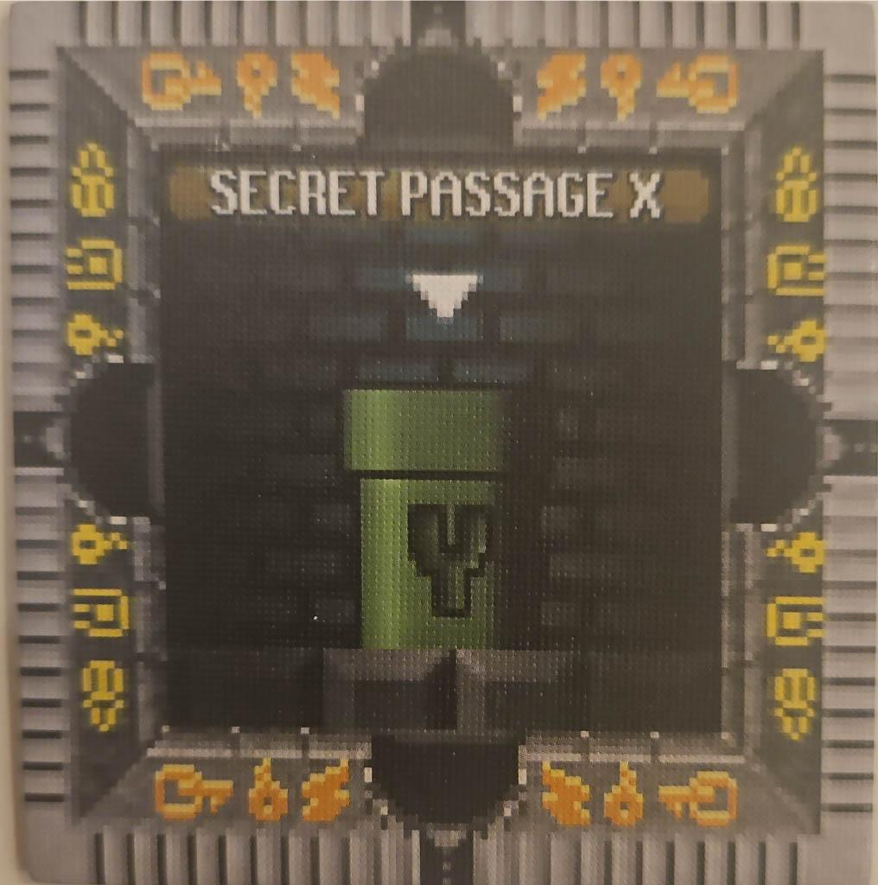
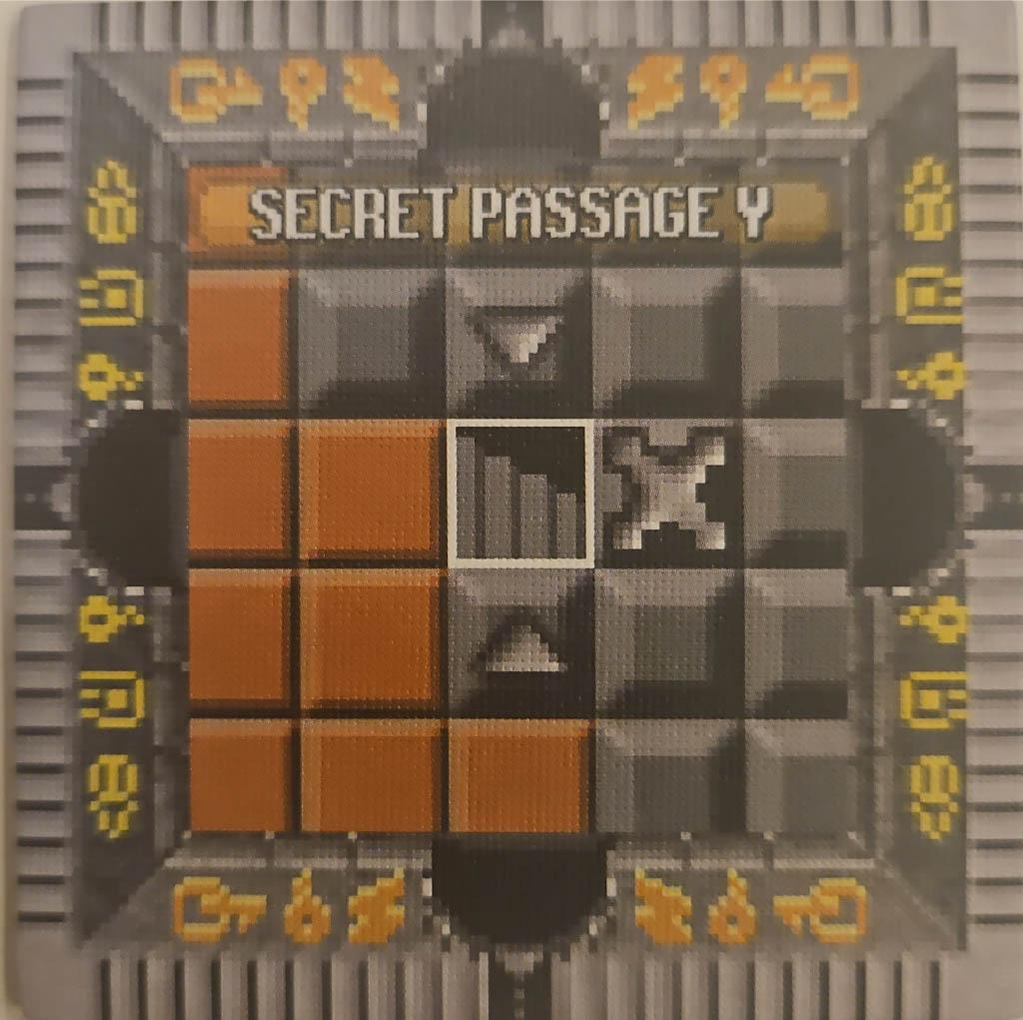
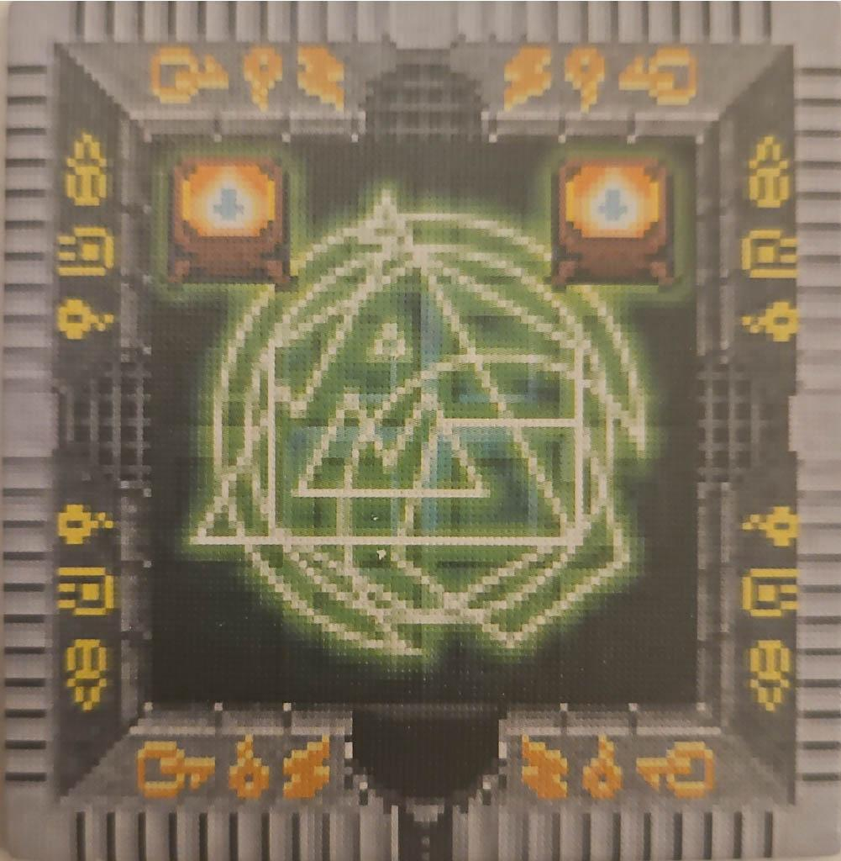
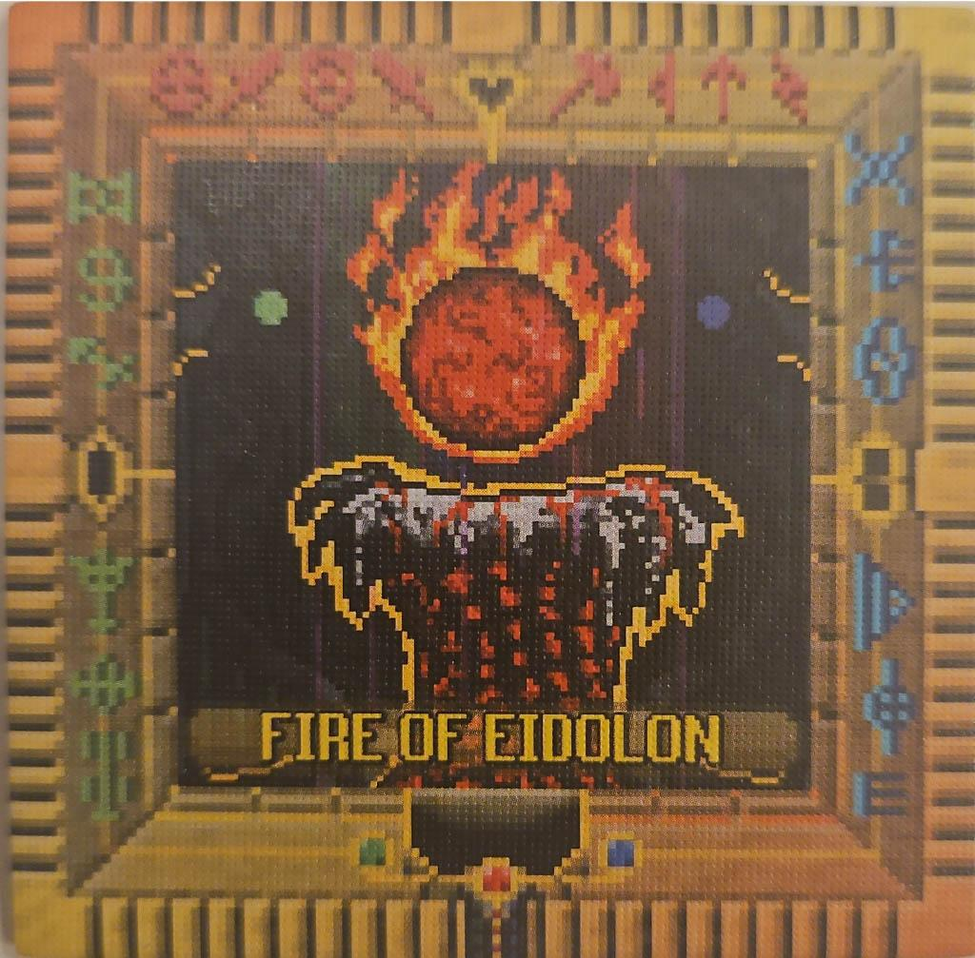
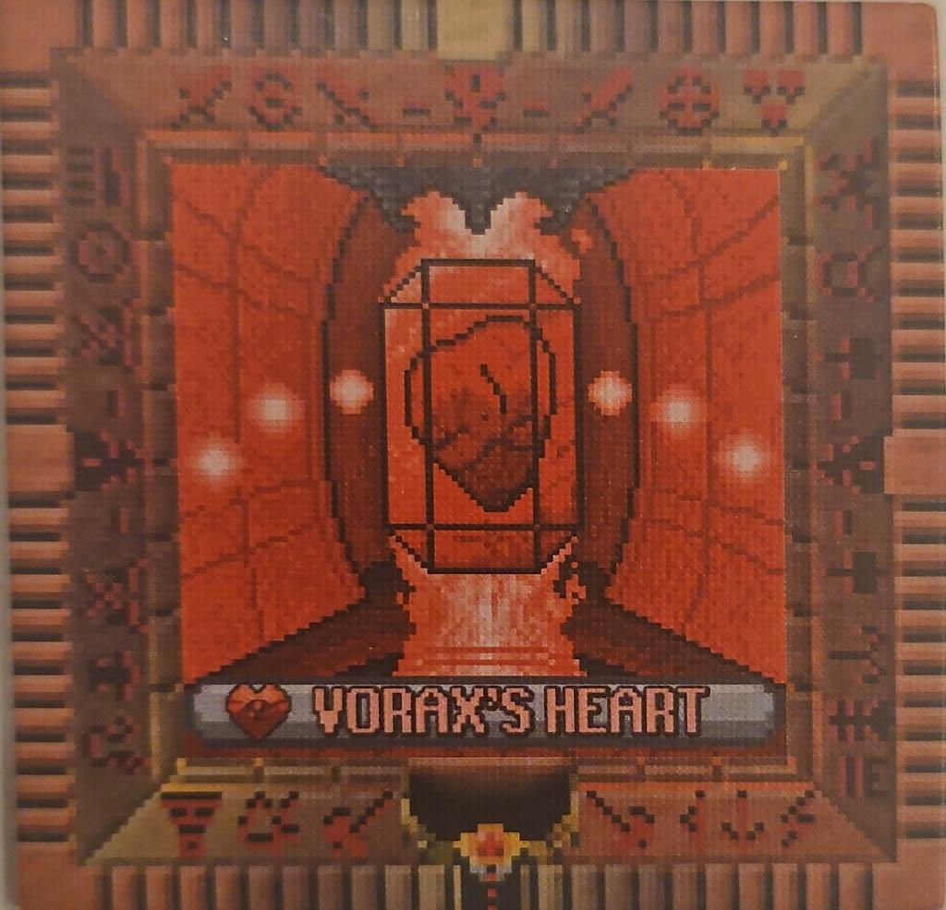
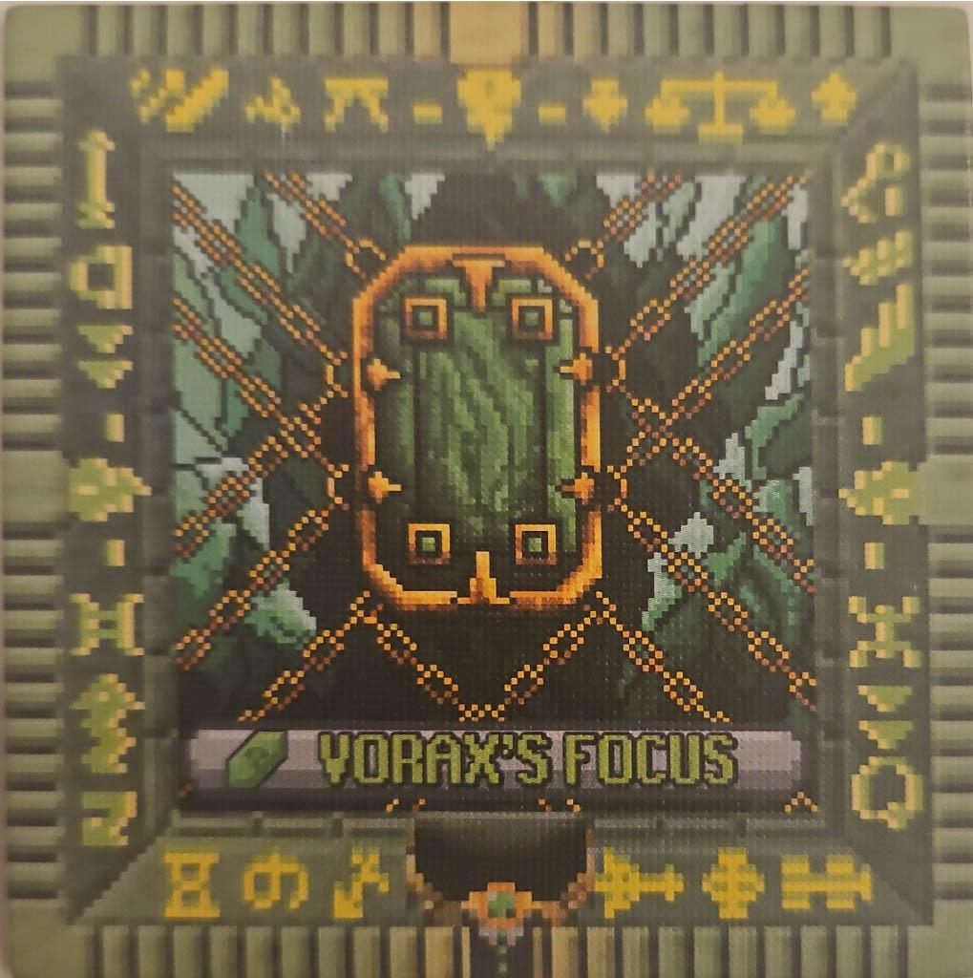
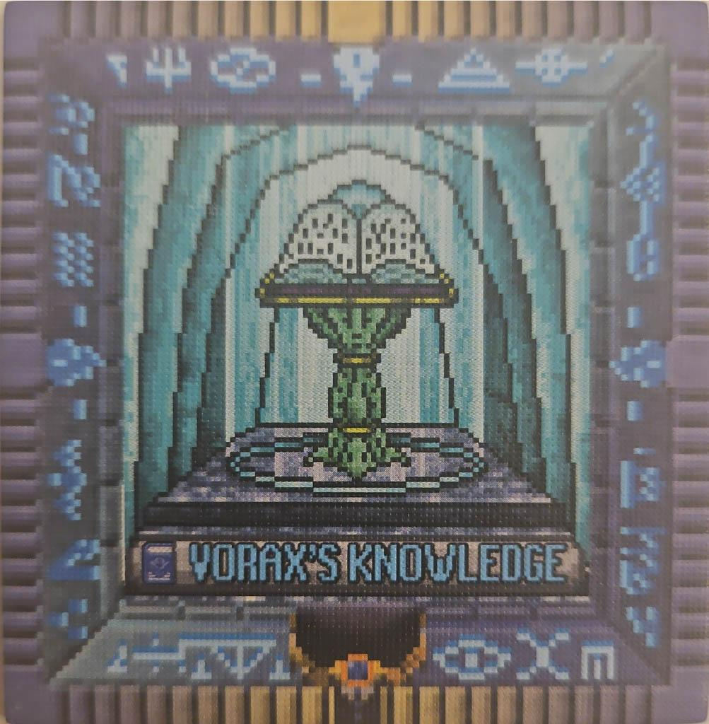

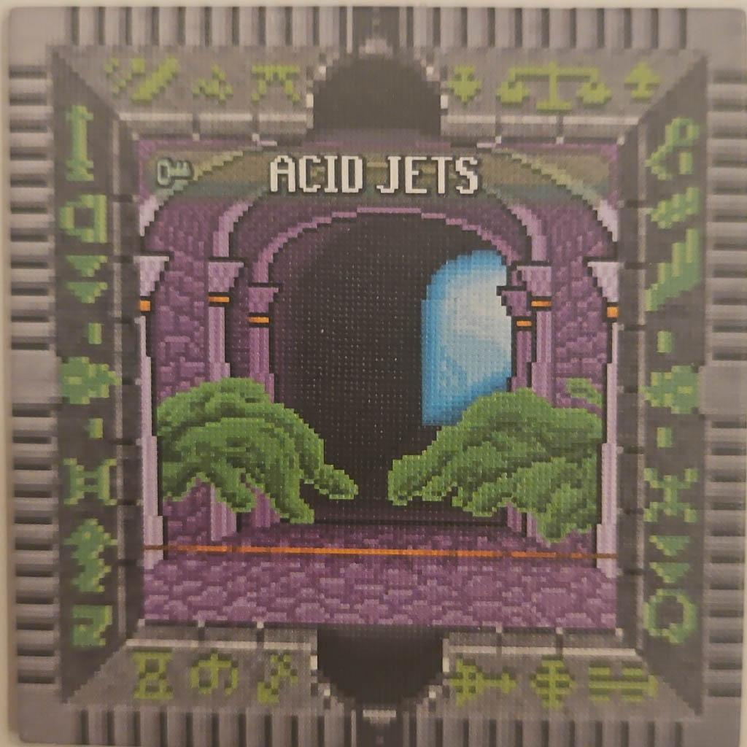
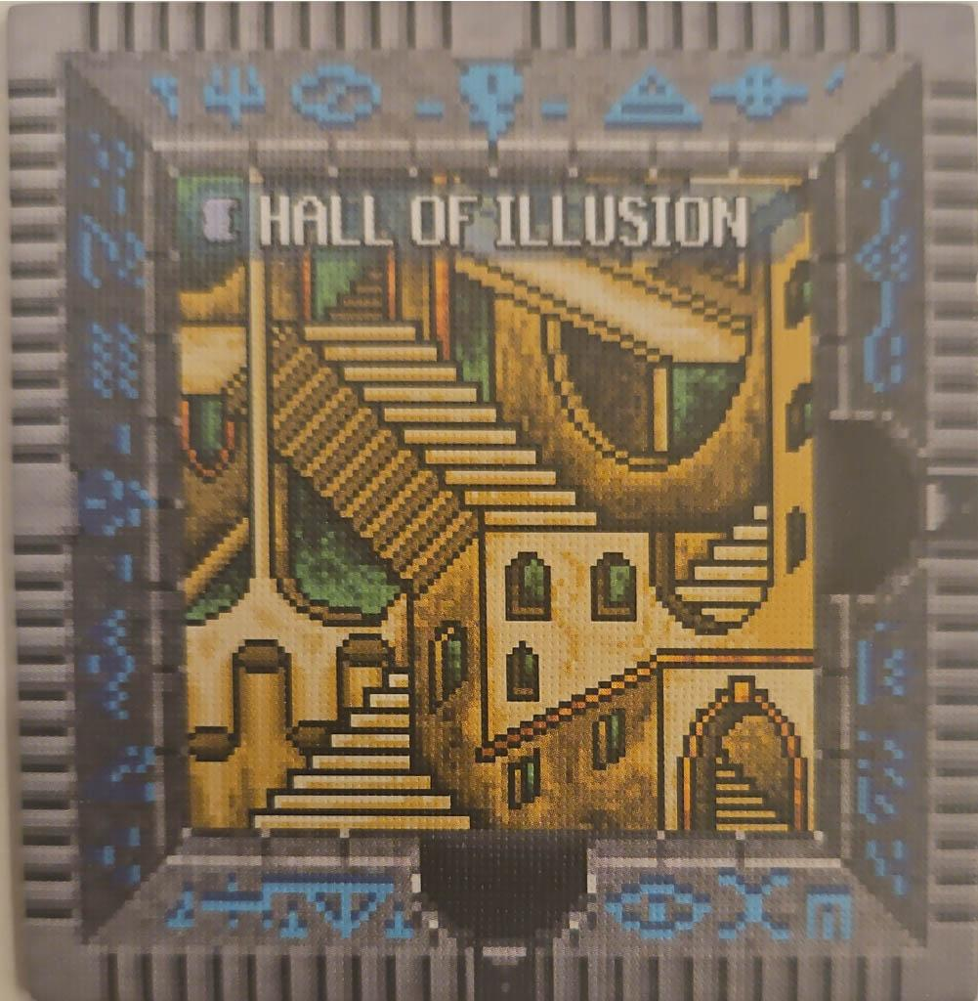
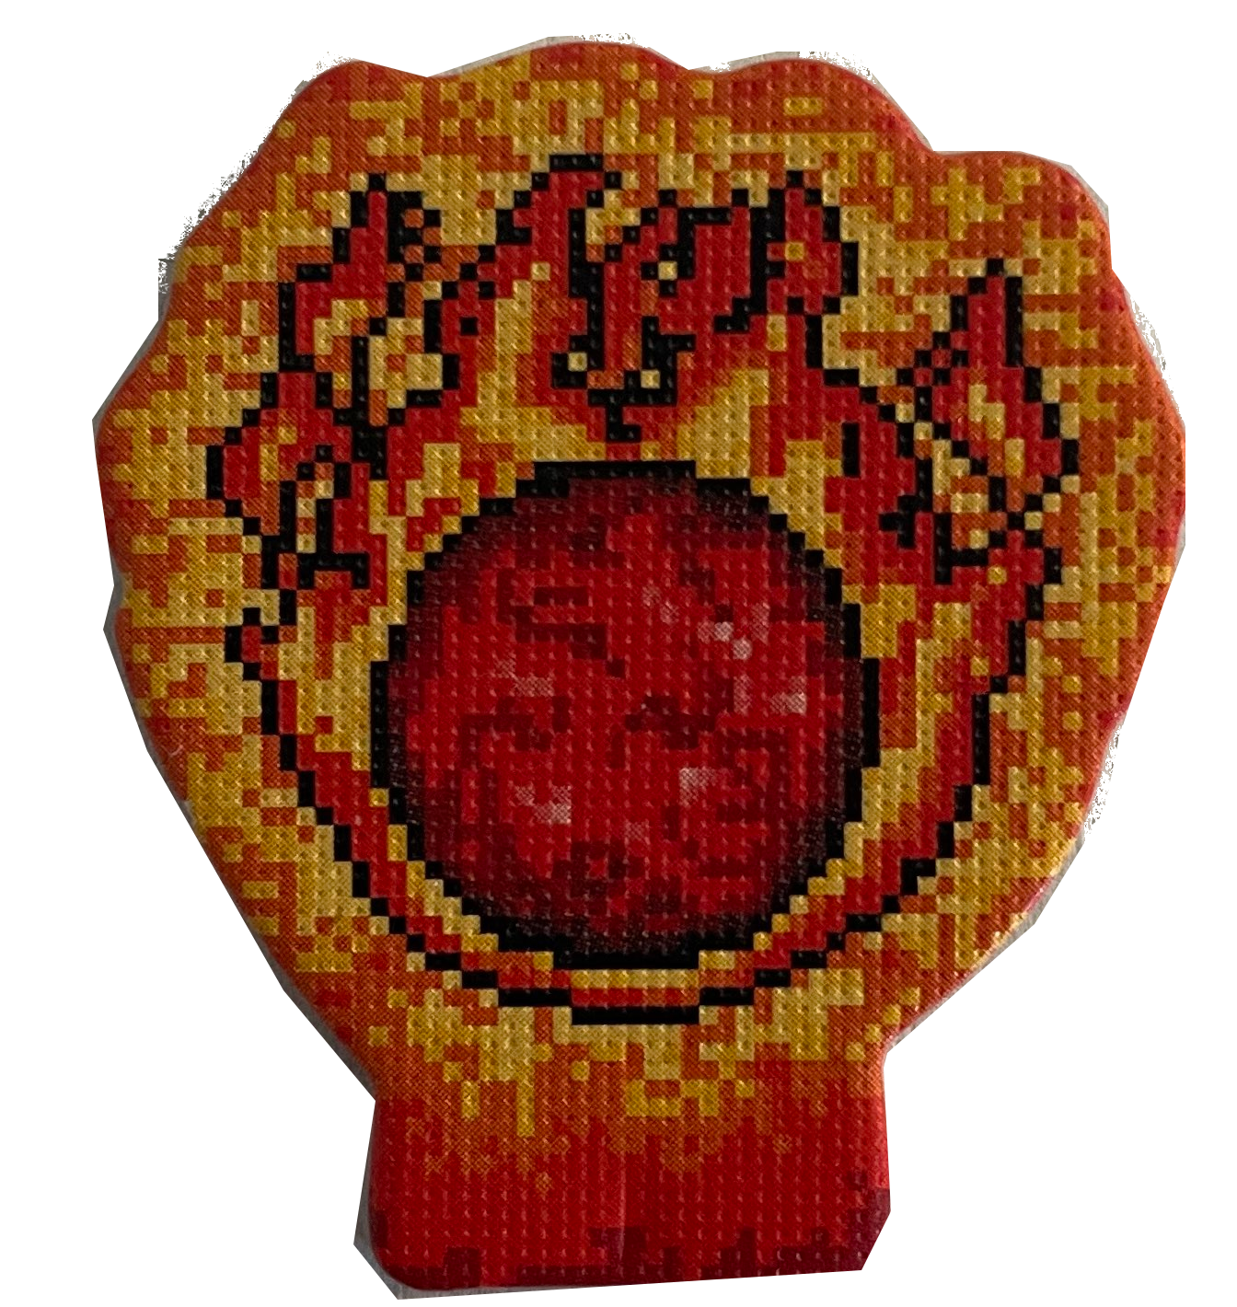

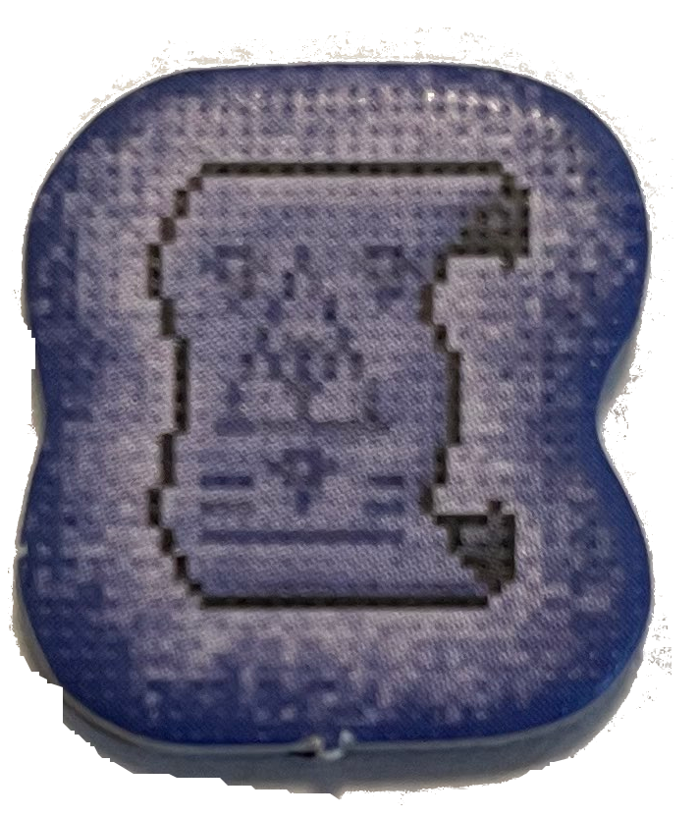
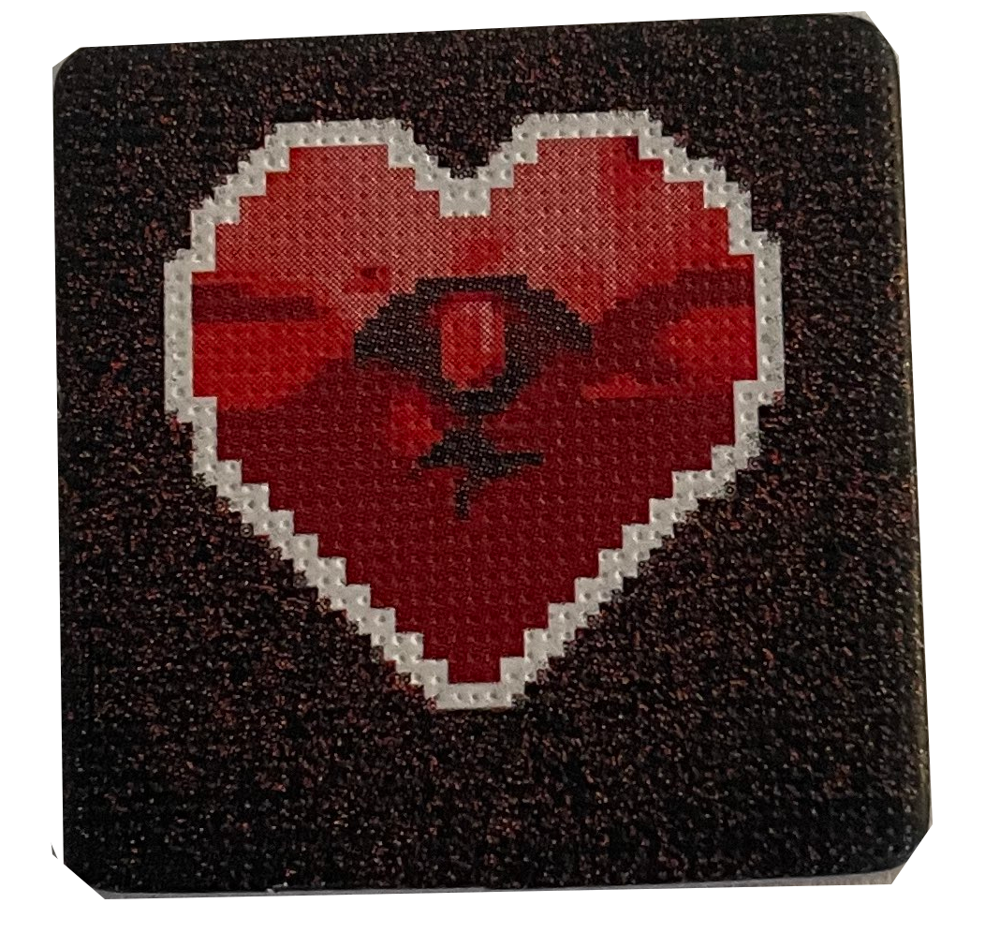


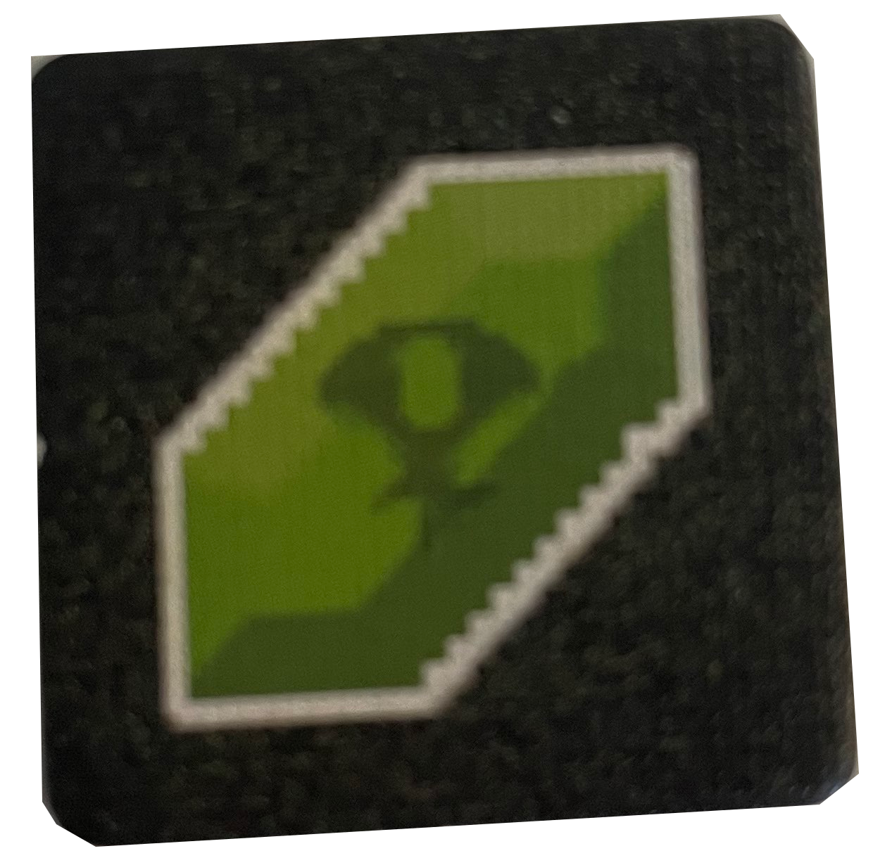
Filler Tile/Obstacle
Start Tile
Secret Passages
End Tile
Fire of Eidolon
Event Tiles
Examples of Color Tiles
Event Tokens
ColorTokens
Fire of Eidolon
Player
Notes:
Josh
Just a quick rundown to help you understand what we are talking about. These filler tiles were used to signify the player couldn’t move in that space. The start tile is where the player starts. The secret tunnels let you warp to one another for one action. The end tile is where you want to bring the fire of eidolon. The event tiles have event tokens that have to be broken before getting the fire of eidolon from the fire of eidolon tile. There are three primary color tiles red, green, blue with a wide variation of door positions, that put out their respective color token, and finally there is the player. For the examples in this presentation we will be using Magic Meeple Game’s all powerful mascot as our player as thanks for their support!

Slide 5
Applied Algorithms: What we used from class
Random Map Generation
Prioritization (Obstacle Avoidance)
A* Path Planning
Cost functions (to move pick up tiles, etc)
Notes:
Josh

Slide 6
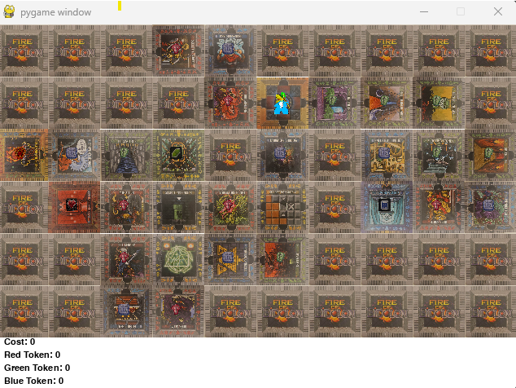
Map Generation: Building the Dungeon
Dungeon is built in grid-like layout
Each tile is unique
Certain Special Tiles with more unique properties
Tiles will have 1-4 doors leading to other tiles
The Dungeon is built with Pygame
Notes:
Josh

Slide 7
Pseudocode of Map Building
Get the list of the tiles to be used
Make a giant map of filler tiles
Replace center of map filler tile with start tile
While there are tiles in the list:
While each cardinal direction hasn’t been checked yet
if door exists in cardinal direction:
If tile space is empty:
Grab random tile from list
Replace the filler tile
Remove replacement tile from list
While replacement tile does not have a door in opposite of previous direction
Rotate replacement tile clockwise
If working tile has uncheck cardinal directions
Save to open_spots list
Set the replacement tile as Working Tile
If no tile has been placed:
Working tile = a random tile from the open_spots list
Notes:
Josh

Slide 8
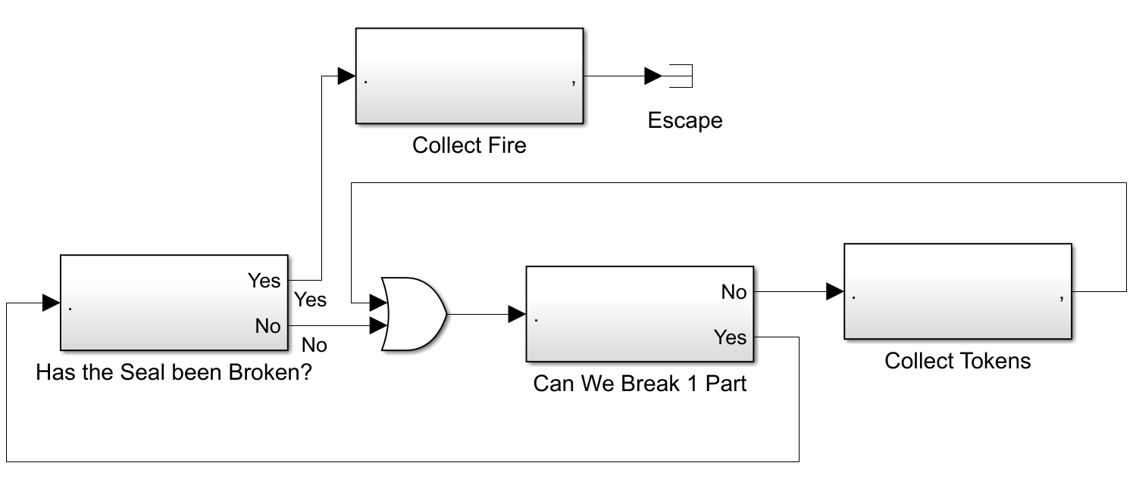
Prioritization: How do you play?
Final Goal: Escape with the Fire of Eidolon
Sub Goal: Unlock Fire of Eidolon by breaking 3 seals
Break seals by collecting associated tokens
Explore dungeon to find goal conditions
Notes:
Tye

Slide 9
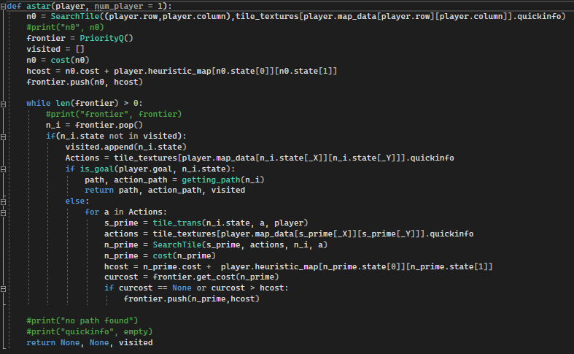
A* Code/Implementation
Notes:
Travis

Slide 10
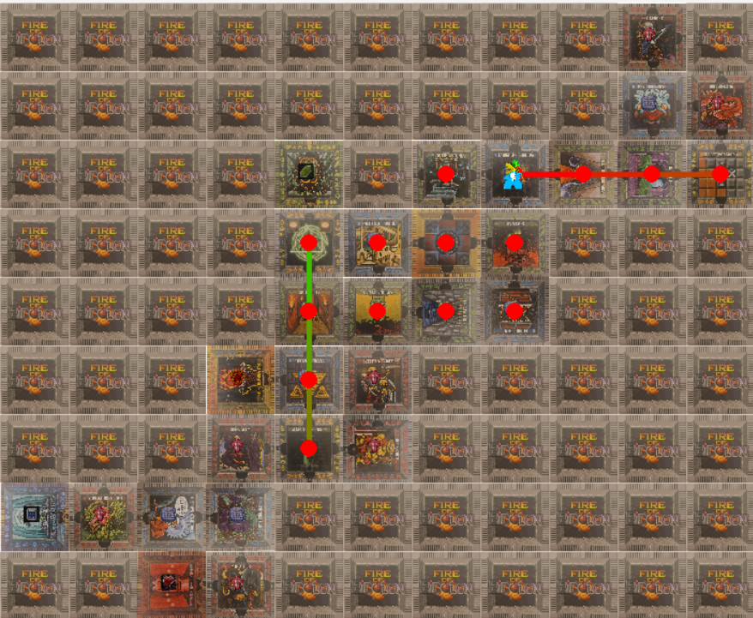
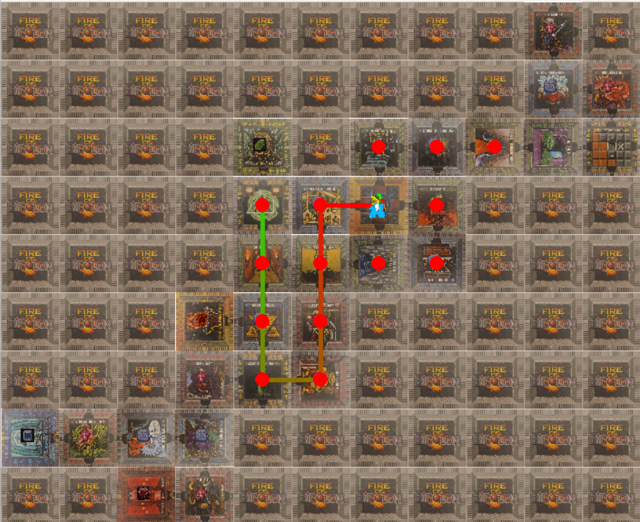
A* Results
Notes:
Travis

Slide 11
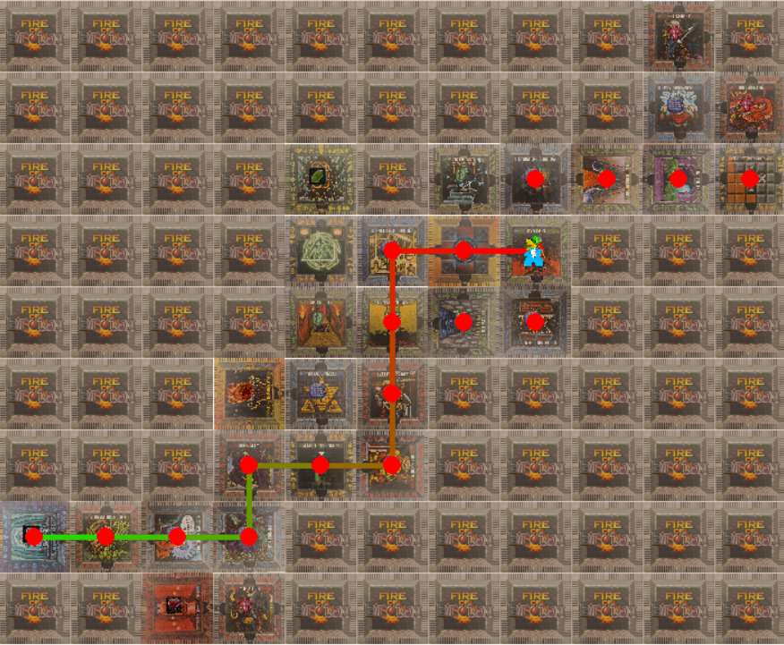
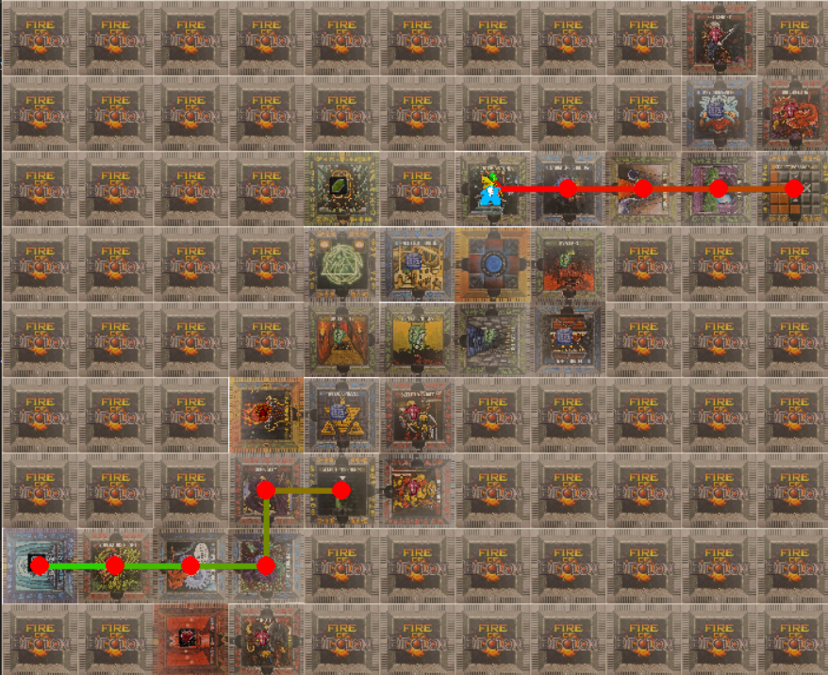
A* Results
Notes:
Travis

Slide 12
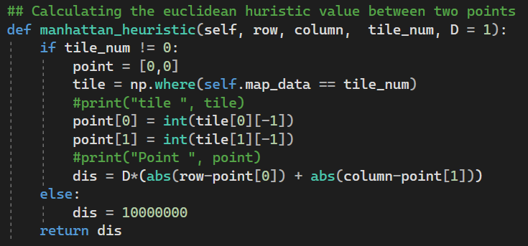
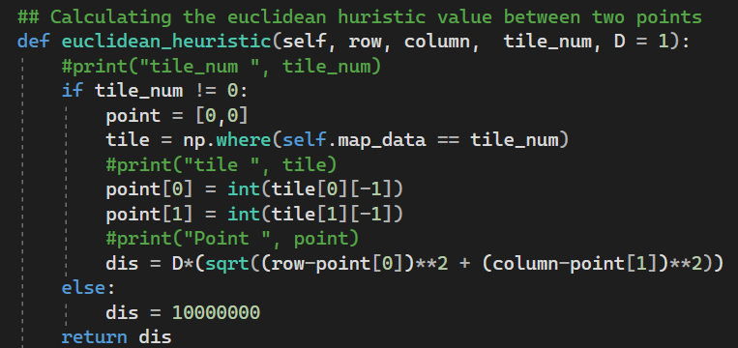
Manhattan Heuristic
Euclidean Heuristic
H = D * (|s_row - g_row| + |s_column - g_column|)
H = Heuristic Cost
D = movement cost
s = start point
g = goal point
H = D * (sqrt((s_row - g_row)² + (s_column - g_column)²)
H = Heuristic Cost
D = movement cost
s = start point
g = goal point
Notes:
We tested both the Manhattan and Euclidean Heuristic models in our program. From the player’s position and we can determine the heuristic cost to any given tile on the map by use of previously assigned tile id numbers. For example if I wanted to find my way to the sphinx’s riddle tile, I would use 24 as my tile_num. If the tile number was a zero, that indicated that tile was one of our obstacle tiles the player can’t pass through. We gave it such a large heuristic cost so the program never even considers that tile a possibility.
We didn’t find much difference between the two Heuristic methods, probably due to the small size of our map. Ultimately we decided to stick with the Manhattan Heuristic since our players won’t be moving diagonally at any point in the game.

Slide 13
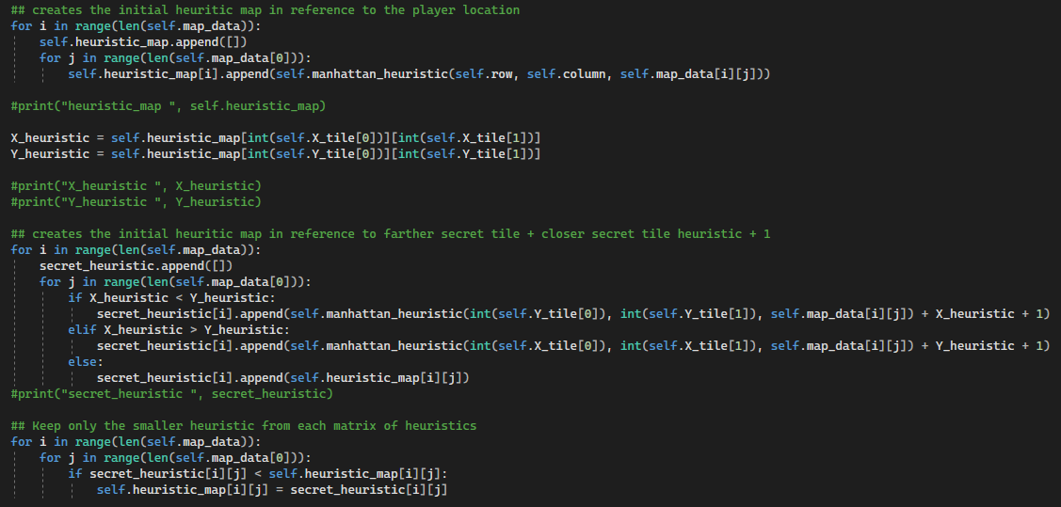
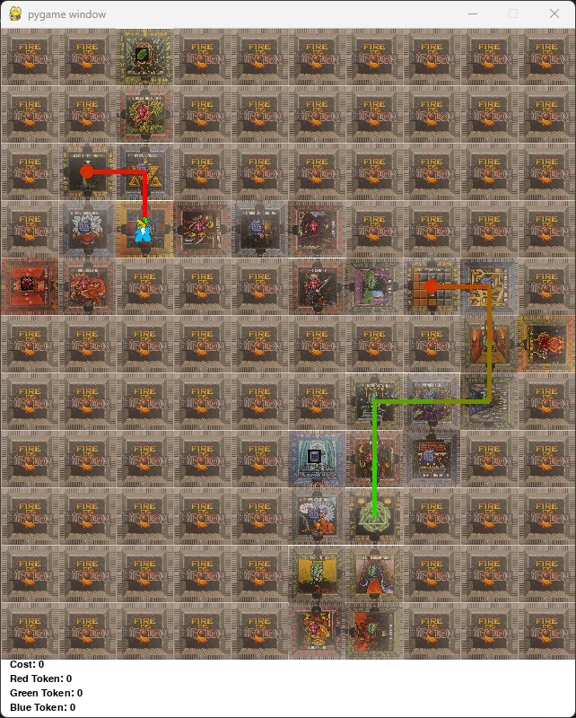
Heuristic for Secret Tunnels
Heuristic Cost:
far_secret_tile = close_secret_tile + 1
Secret Heuristic Map:
Tile = Manhattan_Hearusitic(far_secret_tile) + far_secret_tile
Final Heuristic Map:
Final = smaller(start_heurusitic map, secret_heurustic_map)
Notes:
As part of the game you can move from one secret tunnel to the other only a cost of one action. So it was advantageous for us to use them in cases where taking the tunnel would overall save you steps to the goal, even if that meant moving away from the goal to begin with. Running the heuristics as it was rarely gave us this result in our A* adaptations, especially in spread out maps like this one. We adapted so that after getting the heuristics values for each tile, it would determine which secret tunnel entrance was closer. The farther secret tunnel entrance tile heuristic cost would become equal to the closer secret tunnel entrance tile heuristic cost + 1. We would then find create a second heuristic map based on the farther secret tile and add farther secret tile heuristic value to each of those values. We then compare the two heuristic maps and at each point we keep the smaller heuristic value.
While the example you see here using the starting tile and the end tile, this works just as well from any two given tiles.

Slide 14
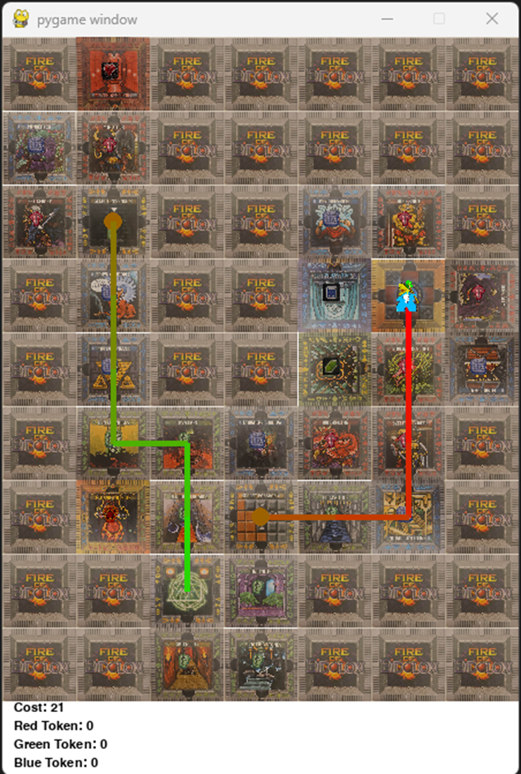
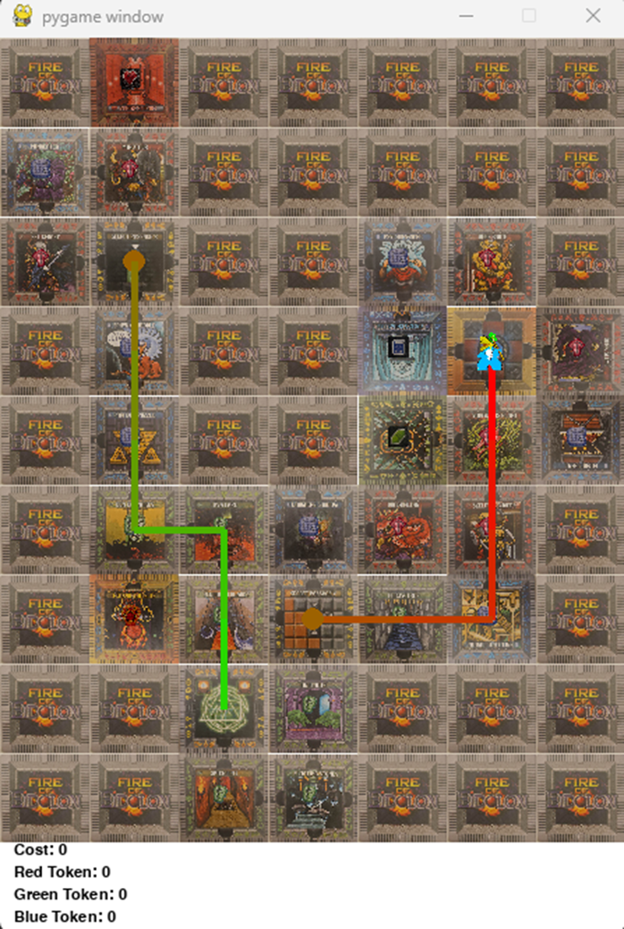
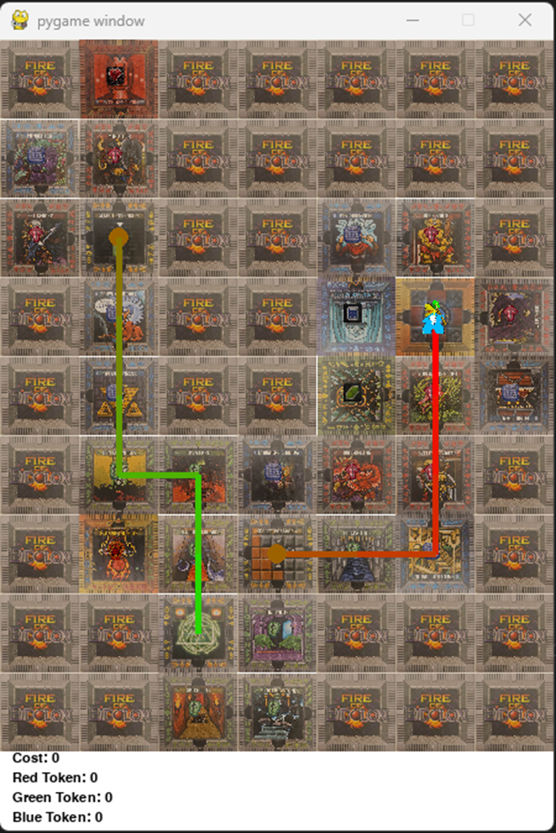
Manhattan
Euclidean
No Secret
Notes:
We ran into a problem when in the Manhattan with or without the extra secret heuristic code it both secret tunnels tiles had the same heuristic cost, the map would sometimes get confused, prioritizing taking the tunnel to rather than continuing on its path. This would also happen with the Euclidean heuristic if we included the secret tunnel portion as you can see above.
In this example all methods determined the fastest path was through the tunnel, because the tunnel was only one more to move and then would find the goal in 12 actions. But if they just went around the bottom it would take 9 actions. This is obviously a problem.
To Answer Questions:
(While without the secret portion, the Euclidean method would work, the Euclidean would then not be able to use the secret tunnel in larger maps as we showed previously. )

Slide 15
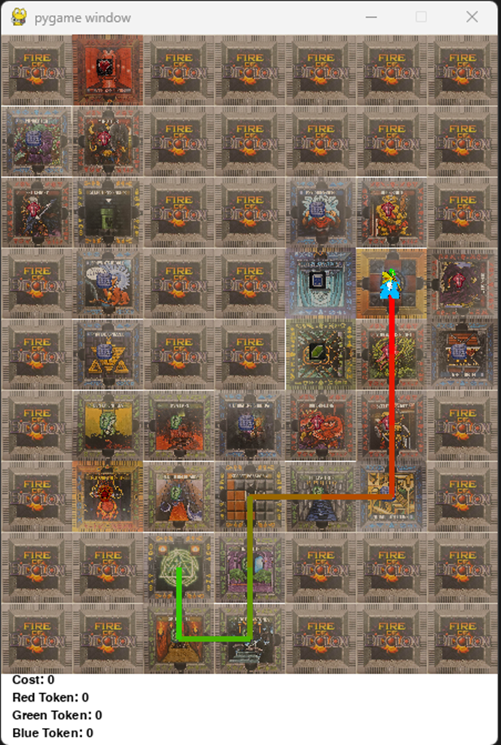
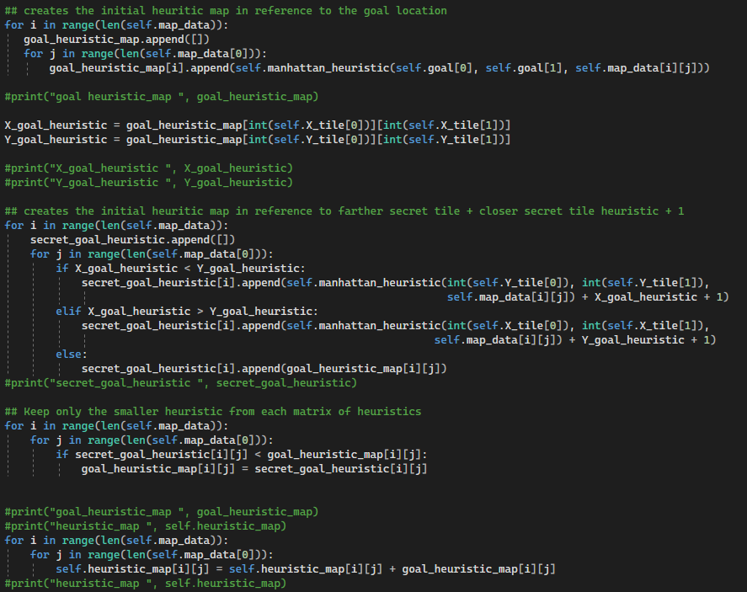
Adding the Goal Heuristic
Notes:
We solved this problem by first running our manhattan heuristic from the player’s position with secret tunnel heuristic part included. Then we would repeat the step from the goal point. We would then add the two heuristic maps together. This would make the tiles that were far away from both the starting point and the goal tile less likely to be used, even if they have a connected tunnel.

Slide 16
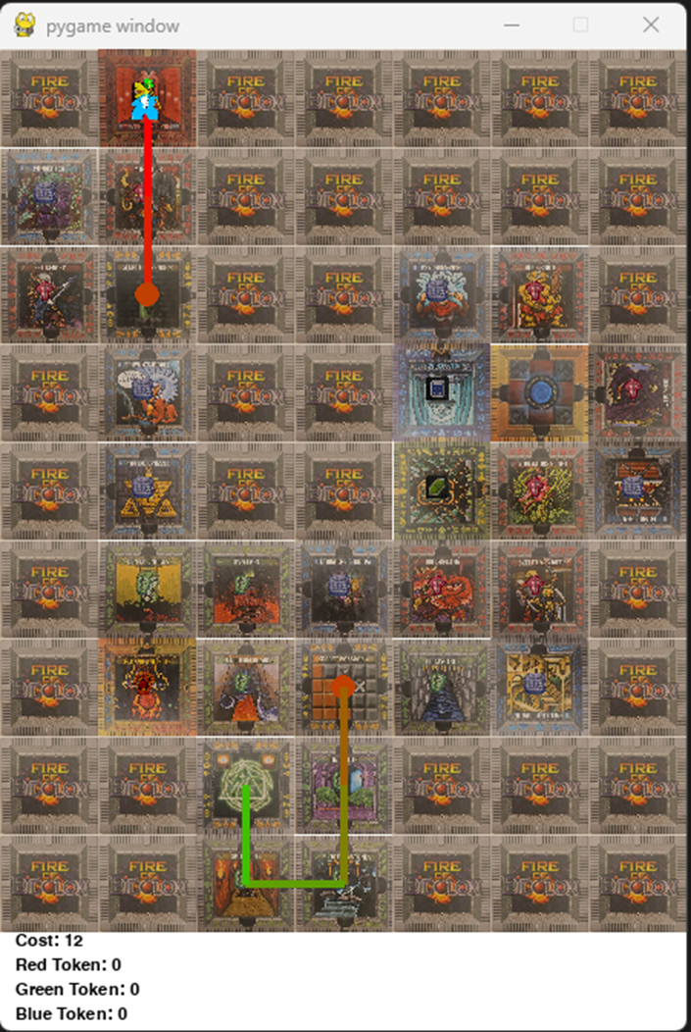
Notes:
Even with that addition it still able to calculate the shortest path if secret tunnel!

Slide 17

What we have now:
VIDEO
Notes:
Tye

Slide 18
Future Implementations
Autonomous Gameplay
Auto task assignment for single/multiple agents
Multiple agents
Picking up tokens more expensive for certain agents
D* Lite Based Real-Time Multi-Agent Path Planning in Dynamic Environments [1]
DARP: Divide Areas Algorithm for Optimal Multi-Robot Coverage Path Planning [2]
Expanded Map
Minions who remove tiles
reduces cost, draws players to tiles w/minions on way towards a goal
Special Abilities - characters can do special moves, ie closer to true gameplay
Notes:
Travis

Slide 19
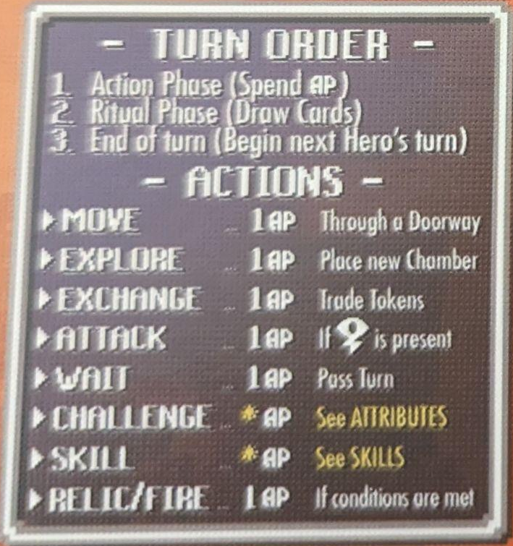
Cost Functions: Not All Actions Are Equal
(Except when they are)
Currently all actions are equal Action Point (AP) cost
Goal cost for actions will be as follows:
Each player will have 3 AP per turn
1 AP to move
AP will
Notes:
Tye

Slide 20
Questions?

Slide 21
Related Works
[1] Real time D* Lite w/multiple agents https://www.researchgate.net/publication/236897587_D_Lite_Based_Real-Time_Multi-Agent_Path_Planning_in_Dynamic_Environments
[2] DARP - Divide Areas Algorithm
https://medium.com/@athanasios.kapoutsis/darp-divide-areas-algorithm-for-optimal-multi-robot-coverage-path-planning-2fed77b990a3

